Slide 2
jakarta ee 8 Part I
Allaithy.raed@coding-akademie

Slide 3

Was ist java ee?
Sammlung von Spezifikationen
Webservices, Transactions, Security,..
APIs = Application Programming Interface

Slide 4

Application server?
Software: Payara, Glasfisch, etc.
Implementiert JAVA EE APIs
Ermöglicht JAVA EE Services

Slide 5
JAVA EE vs. JAKARTA
JAVA EE
Bis 2019 bei Oracle
Schwergewichtet
Backend Framework
JAKARTA EE
Ab 2019 übernahm Eclipse Foundation Java EE
Schlanke Version von JAVA EE
Optimiert für native Cloud Application

Slide 6
Was ist java persistence language (JPL)
Model
Eine Schicht zwischen Model und Datenbank
Bildet Objekte auf relationale Datenbank ab
Generiert DB Tabellen und deren Beziehungen
JPL
DB

Slide 7
Was ist jpql?
String-basierte Anfrage Sprache
"select c from Customer c where c.age > {age}"
Wird intern in SQL Statements übersetzt

Slide 8


Das projekt

Slide 9
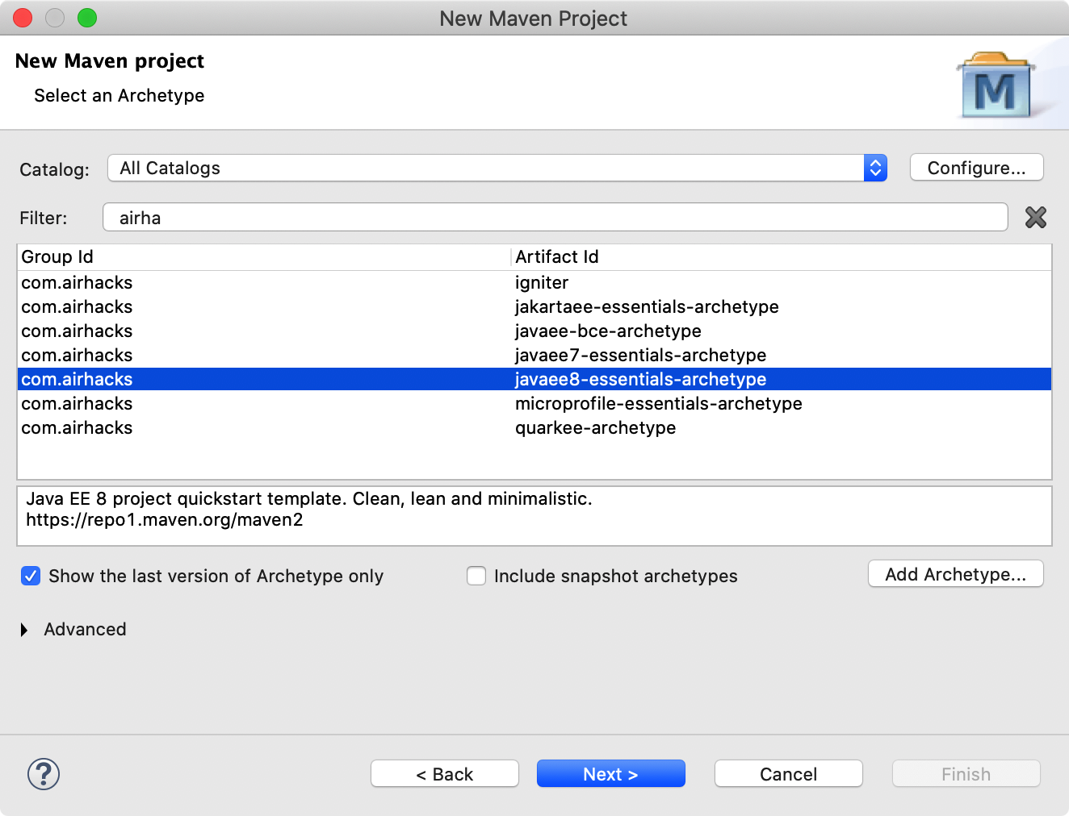
MAVEN Projekt erstellen
File ➔ New ➔ Other
Maven ➔ Maven Projekt
Archetype: airhacks
javaee-essential-archtype
Group Id : com.bmw
Artifact Id: caro
Finish

Slide 10
Entity erzeugen
public class Customer {
@Id
@GeneratedValue(strategy = GenerationType.AUTO)
private Long id;
private String name;
private LocalDate createdDate;
private boolean active;
+ Setter and Getterns
}

Slide 11
Entity erzeugen
@Entity
public class Vehicle {
@Id
@GeneratedValue(strategy = GenerationType.AUTO)
private Long id;
private String identifier;
private Color color;
private EngingeType engineType;
}

Slide 12
Wichtige JPL Annotationen I
Annotation | Bedeutung
@Entity | Mappt eine Klasse auf eine Datenbank Tabelle
@Table(name = “tablename”) | Definiert einen Table Name (Standard: Klassename)
@Column(name = spaltenname) | Definiert einen Spaltennamen (Standard: Instanzvariable)
@MappedSuperclass | Annotiert die Superklasse
@Enumerated(EnumType.String) | Enumeration werden als String in Datenbank gespeichert
@Tranient | Variable wird nicht gespeichert
@PrePersist | Lifecycle Callback

Slide 13
Wichtige JPL Annotationen II
Annotation | Bedeutung
@OneToONe | 1-1 Beziehung
@OneToMany | 1-N Beziehung
@ManyToOne | N-1 Beziehung
@ManyToMany | N-M Beziehung
@cascade(CascadeType. ) | ALL, PERSIST, REMOVE,…
@mappedBy(“otherKlass_refer”) | Welche Klasse verwaltet die Beziehung? (Fremdschlüssel)
@fetch | EAGER | LAZY
@JointColumn (name = “schluessel”) | Fremdschlüssel Spaltenname

Slide 14
Data access object pattern (DAO in java se)
Customer
benutz
CustomerDAOImpl
CustomerDAO
List<CustomerDAO>
CRUD
implementiert
DB

Slide 15
Persistence in java ee
JPL
@entity
class Customer
CDI
class CustomerService
@PersistenceContext(unitName = “pu”)
private EntityManager entityManager
CRUD = create, read, update, delete
class PersistenceService für alle
Oder pro class ein PersistenceService
EJB
@stateless
class CustomerService

Slide 16
Persistence xml
<?xml version="1.0" encoding="UTF-8"?>
<persistence version="2.1"
xmlns=http://xmlns.jcp.org/xml/ns/persistence xmlns:xsi="http://www.w3.org/2001/XMLSchema-instance" xsi:schemaLocation="http://xmlns.jcp.org/xml/ns/persistence http://xmlns.jcp.org/xml/ns/persistence/persistence_2_1.xsd">
<persistence-unit name=”unit-name" transaction-type="JTA">
<jta-data-source>java:app/caro/datasource</jta-data-source>
<!-- class>com.bmw.entity.customer</class -->
<exclude-unlisted-classes>false</exclude-unlisted-classes>
<properties>
<property
name="javax.persistence.schema-generation.database.action” value="drop-and-create" />
</properties>
</persistence-unit> </persistence>

Slide 17
EJB Stateless
package com.bmw.service;
@Stateless
public class CustomerService {
@PersistenceContext
EntityManager entityManager;

Slide 18
Statefull vs. stateless
Statefull
Schneller bei dem Client
Brauchen backing Storage
Server-side State abhängig
Stateless
Einfacher Server Design
Merkt keine Details und Sessions
Keine Anfragen Abhängigkeiten

Slide 19

CRUD: CREATE
public Customer create(Customer customer) {
entityManager.persist(customer);
return customer;
}

Slide 20

CRUD: REad
public Customer read(Long id) {
return entityManager.find(Customer.class, id);
}

Slide 21

CRUD: Update
public Customer update(Customer customer) {
entityManager.merge(customer);
return customer;
}

Slide 22

CRUD: Delete
public void delete(Customer customer) {
entityManager.remove(customer);
}

Slide 23
Rest endpoint
REST Web Service Server
Client
HTTP Request
HTTP Response

Slide 24

Rest endpoint: definiere die rest klasse(n)
@Path(“MyClassRest-Path”)
Communication MediaType festlegen
@Consumes(MediaType.APPLICATION_JSON)
@Produces(MediaType.APPLICATION_JSON)
class CustomerRest {…}

Slide 25
Rest endpoint: definiere die rest klasse(n)
@Path("customer")
@Consumes(MediaType.APPLICATION_JSON)
@Produces(MediaType.APPLICATION_JSON)
public class CustomerRest {
@Inject
CustomerService customerService;

Slide 26
Wichtige REST API Annotation
Annotation | Bedeutung
@Path(path-to-the-world) | URL Adresse über die das Dienst erreichbar ist
@POST | Für das erstmalige Speichern: Write-Anfragen
@PUT | Für update: Write-Anfragen
@GET | Für Read-Only Anfragen

Slide 27
CRUD Operation Rest api
Entity
Persistence
Service
GUI
JPL
Entity
REST AP
Security
Query
Servce
DB
Entity

Slide 28
Customer-rest crud: Create
@Path("create")
@POST
public Response create(Customer customer) {
customerService.create(customer);
return Response.ok(customer).build();
}

Slide 29
Customer-rest crud: READ
@Path(”read")
@PGET
public Response update(Long id) {
customerService.read(id);
return Response.ok(customer).build();
}

Slide 30
Customer-rest crud: Update
@Path(”update")
@PUT
public Response update(Customer customer) {
customerService.update(customer);
return Response.ok(customer).build();
}

Slide 31

Lifecycle Callback
@PrePersist
private void init() {
setDateCreated(LocalDate.now());
}

Slide 32

QUERy-SERVICE:
@Stateless
public class QueryService {
@PersistenceContext
private EntityManager entityManager;

Slide 33
QUERy-SERVICE: find all
public List<Customer> findAll() {
return entityManager
.createQuery("Select c from Customer c", Customer.class)
.getResultList();
}

Slide 34

REST API find all
@Path("all")
@GET
public List<Customer> findAll(){
return customerService.findAll();
}

Slide 35
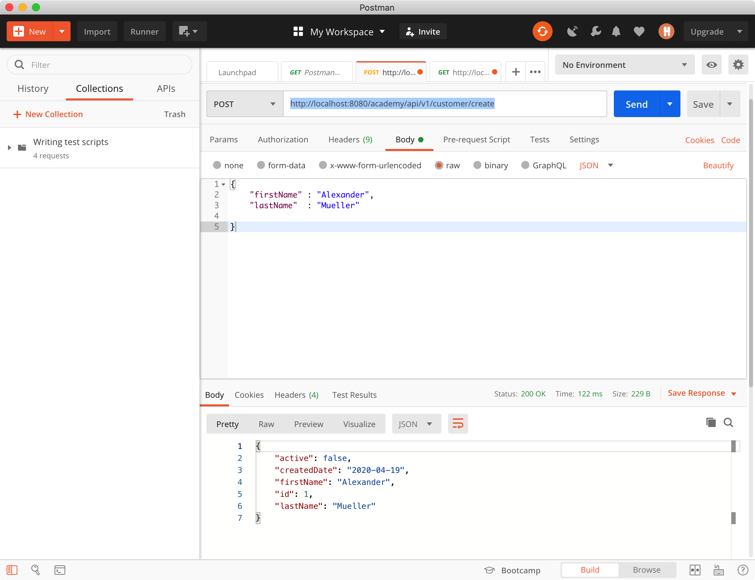
Application test mit postman

Slide 36
Bean validation
Annotation | Bedeutung
@NotEmpty(message = “msg”) | Field darf nicht leer sein
@NotNull(message = “msg”) | Field darf nicht null Wert haben
@Size(min=int, max=int, message = “msg”) | Min, Max Character
@Pattern(regexp = “regexp”, message = “msg”) | Erlaubte Pattern
@Pattern(regexp = "^[A-Za-z0-9+_.-]+@(.+)$") | Beispiel für Email
@FutureOrPresent(message = “no past date”) | Datum darf nicht in Vergangenheit liegen
@JsonbDateFormat(value = "yyyy-MM-dd") | Datum Format erzwingen

Slide 37

Validation Beispiel I
@NotEmpty(message = "last name should not be empty!")
@Size(min =3, max = 20, message = ”Min 3, Max 20 ")
private String lastName;

Slide 38
Validation Beispiel II
@NotEmpty
@Email(message = "Email in Format name@domain.xxx")
@Pattern(regexp = "^[A-Za-z0-9+_.-]+@(.+)$")
private String email;

Slide 39
Validation Beispiel III
@NotNull
@FutureOrPresent(message = "Date should not be in the past")
@JsonbDateFormat(value = "yyyy-MM-dd")
private LocalDate createdDate;

Slide 40
Invalid exception mapper
@Provider
public class ConstraintViolationExceptionMapper implements ExceptionMapper<ConstraintViolationException> {
@Override
public Response toResponse(ConstraintViolationException exception) {
return Response.status(Response.Status.BAD_REQUEST)
.header("X-Validation-Error", exception.getMessage())
.entity(exception.getMessage())
.build();
}

Slide 41
Exception in eigene klasse verpacken
public class CustomerCreationException extends RuntimeException{
public CustomerCreationException(String message) {
super(message);
}

Slide 42
Hilfsklasse für bessere ausgabe
public class RestError {
private UUID ref;
private Integer status;
private String code;
private String msg;

Slide 43
Mapper mit eigenen klassen
@Provider
public class CustomerCreationMapper implements ExceptionMapper<CustomerCreationException> {
@Override
public Response toResponse(CustomerCreationException e) {
RestError error = new RestError();
error.setRef(UUID.randomUUID());
error.setStatus(405);
error.setCode("entity.costumer");
error.setMsg("Invalid Customer Input!");
returnResponse.status(Response.Status.BAD_REQUEST)
.entity(error).build();
}

Slide 44
JPQL
NAMED Query
Native Query
Dynamische Query

Slide 45

NAMED Query in entity
@NamedQuery (name = “Name of Query”, query = “JPQL Query Syntax”)

Slide 46
NAMED Query in entity (Beispiel 1)
@NamedQuery(name = Customer.ALL, query = "select c from Customer c order by c.name ")
@Entity
public class Customer {
public static final String ALL= "ALL_CUSTOMERS";

Slide 47

NAMED Query in Query Service (Beispiel 1)
@Stateless
public class QueryService {
@PersistenceContext
EntityManager entityManager;
public List<Customer> findAllCustomer(){
return entityManager.createNamedQuery(Customer.ALL, Customer.class)
.getResultList();
}

Slide 48
NAMED Query in REST API (Beispiel 1)
public class CustomerRest {
@Inject
QueryService queryService;
@GET
@Path("list")
public Response listAllTodoUsers() {
return Response.ok(queryService.findAllCustomer()).build();
}

Slide 49
JPQL
NAMED Query Beispiel 2

Slide 50
NAMED Query in entity (Beispiel 2)
@NamedQuery(name = Customer.BY_PATTERN,
query = "select c from Customer c where c.name like :name ")
@Entity
public class Customer {
public static final String BY_PATTERN= ”find.ByPattern";

Slide 51

NAMED Query in Query Service (Beispiel 2)
@Stateless
public class QueryService {
@PersistenceContext
EntityManager entityManager;
public Collection<Customer> findCustomerByPattern(String name) {
return entityManager
.createNamedQuery(Customer.BY_PATTERN, Customer.class)
.setParameter("name", "%" +name+ "%")
.getResultList();
}

Slide 52

NAMED Query in REST API (Beispiel 2)
public class CustomerRest {
@Inject
QueryService queryService;
@Path(”name") // url/car2/resource/customer/name?=la
@GET
public Response findCustomerByPattern(@QueryParam("name") String name) {
Collection<Customer> result = queryService.findCustomerByPattern(name);
return Response.ok(result).build();
}

Slide 53
JPQL
NAMED Query Bespiel 3

Slide 54
NAMED Query in entity (Beispiel 3)
@NamedQuery(name = Customer.BY_PATTERN,
query = "select c from Customer c where c.email = :email ")
@Entity
public class Customer {
public static final String BY_EMAIL= ”find.ByEmail";

Slide 55
NAMED Query in Query Service (Beispiel 3)
@Stateless
public class QueryService {
public TodoUser findCustomerByEmail(String email) {
try {
// NoResultException, NonUniqueResultException, IllegalStateException by delete or update
return entityManager
.createNamedQuery(Customer.BY_EMAIL, Customer.class)
.setParameter("email", email)
.getSingleResult();
} catch(NonUniqueResultException | NoResultException exception) {
return null;
} }

Slide 56
NAMED Query in REST API (Beispiel 3)
public class CustomerRest {
@Inject
QueryService queryService;
@Path("find/{email}") // Dynamic Segment: url/find/email
@GET
// public TodoUser findTodoUserByEmail(@NotNull @PathParam("email") @DefaultValue("") String email) {
public Customer findCustomerByEmail(@PathParam("email") @DefaultValue("") String email) {
return queryService.findCustomerByEmail(email);
}

Slide 57
PROBLEM
DUPLIKATE !!

Slide 58

Customer-rest crud: Create
Unser Lösung erlaubt Duplikate!
Lösung: Email eindeutig!
Anzahl gespeicherte Emails!

Slide 59
JPQL
Dynamic Query
Native Query

Slide 60
Native Query in Query Service (Beispiel 4)
@Stateless
public class QueryService {
public List countCustomerByEmail(String email) {
List resultList =
entityManager
.createNativeQuery("select count (id) from CustomerTable
where exists (select id from CustomerTable where email = ?)")
.setParameter(1, email).getResultList();
return resultList;
}

Slide 61
NAMED Query in REST API (Beispiel 4)
public class CustomerRest {
@Inject
QueryService queryService;
@GET
@Path("count")
public Response countCustomerByEmail(@QueryParam("email”)String email) {
return Response.ok(queryService.countCustomerByEmail(email)).build();
}

Slide 62
PERSISTENCE SERVICE Anpassen!
public Customer create(Customer customer) {
List list = queryService.countCustomerrByEmail(customer.getEmail());
Integer count = (Integer) list.get(0);
if (customer.getId() == null && count == 0) {
entityManager.persist(customer);
}
return todoUser;
}

Slide 63
JPL BEziehungen
OneToOne
OneToMany
ManyToOne
ManyToMany

Slide 64
Customer
1
Address
1-1 Beziehung
0..1
Customer
1
Email
1-N Beziehung
0..*
Customer
1..*
Vehicle
N-M Beziehung
1..*

Slide 65

public class Customer {
private Address address
private Set<Email> emails;
// one-to-one
// one-to-many
Customer customer = new Customer();
customer.getAddress().getCity();
// navigieren

Slide 66
Unidirektional Beziehung
Customer
Address
- address: Address
In Java: von links nach rechts navigierbar: Customer => Address
In Datenbank: von beiden Seiten navigierbar: Person ⬄ Address

Slide 67
Bidirektional Beziehung
Customer
Address
- address: Address
- customer: Customer
In JAVA und in DB in beiden Seiten navigierbar!

Slide 68
Mapping von 1:1 Beziehung
Customer
1
Address
0..1
@Entity
public class Customer {
..
@OneToOne
(mappedBy = ”customer",
cascade=CascadeType.ALL)
private Address address;
@Entity
public class Address {
..
@OneToOne
private Customer customer;

Slide 69
Mapping von 1:1 Beziehung Tabellen
public class Customer {
@OneToOne(mappedBy = ”customer")
private Address address;
ID
NAME
Weitere Daten
101
Alex
….
@Entity
public class Address {
@OneToOne
private Customer customer;
ID
CITY
Weitere Daten
CUSTOOMER_ID
27
Munich
Weitere Daten
101

Slide 70
Mapping Bidirektionale von 1:N Beziehung
Customer
1
Email
0..*
@Entity
public class Customer {
@OneToMany(mappedBy="customer")
private Set<Email> emails;
@Entity
public class Email {
@ManyToOne
private Customer customer;

Slide 71
1-N Bidirektionales Mapping Tabellen
@Entity
public class Customer {
@OneToMany
private Set<Email> emails;
ID
NAME
Weitere Daten
101
Alex
….
@ManyToOne verfügt über kein mappedBy
ID
EMAIL
CUSTOMER_ID
public class Email {
@ManyToOne
private Customer customer;
}
47
alex@m.de
101
57
a.x@m.de
101

Slide 72
Unidirektionales Mapping von 1:N Beziehung
Customer
1
Email
1-N Beziehung
0..*
@Entity
public class Customer {
@OneToMany
private Set<Email> emails;
Gleiche Attribute wie bei @OneToOne

Slide 73
1-N Unidirektionales Mapping Tabellen
@Entity
public class Customer {
@OneToMany
private Set<Email> emails;
ID
NAME
Weitere Daten
101
Alex
….
CUSTOMER_ID
EMAIL_ID
JOINED Tabelle
101
47
public class Email {
private String email;
}
ID
EMAIL
Weitere Daten
47
alex@m.de
…

Slide 74
Mapping Bidirektionales N:M Beziehung
Customer
1..*
Vehicle
1..*
@Entity
public class Customer {
@ManyToMany
private Set<Vehicle> vehicles;
@Entity
public class Vehicle {
@ManyToMany(mappedBy=”vehicles")
Private Set<Customer> customers;

Slide 75
N-M Mapping Tabellen
@Entity
public class Customer {
@ManyToMany
private Set<Vehicle> vehicles;
ID
NAME
Weitere Daten
101
Alex
….
CUSTOMER_ID
VEHICLE_ID
JOINED Tabelle
101
35
ID
COLOR
Weitere Daten
35
RED
…

Slide 76
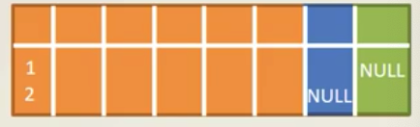

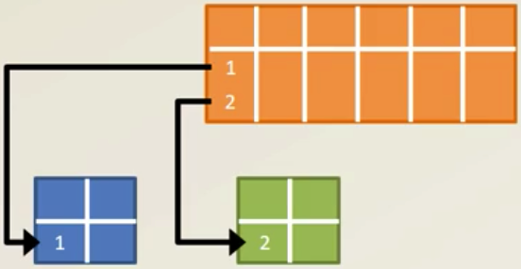

Verebungshierarchie in JPA
Customer extends Person
Employee extends Person
SINGLE_TABLE
TABLE_PER_CLASS
JOINED

Slide 77
AUFGABE
class Address
class
ManyToOne
ManyToMany

Slide 78
PROBLEM
Für Logged-in User
Seine Vehicle suchen!
Lösung: Session

Slide 79
Merke den Customer durch session
@SessionScoped
public class UserSession implements Serializable{
private static final long serialVersionUID = 1L;
private String email;
public String getEmail() {
return email;
}
public void setEmail(String email) {
this.email = email;
}
}

Slide 80
Die Klasse Vehicle
@Entity
@NamedQuery(name = Vehicle.ALL_BY_OWNER_EMAIL,
query = "select v from Vehicle v where v.customer.email = :email")
public class Vehicle {
public static final String ALL_BY_OWNER_EMAIL = "Find.CustomerVehicle";
@ManyToOne
@JoinColumn(name = ”Customer_Id")
private Customer customer;
}

Slide 81
in Query Service
@Stateless
public class QueryService {
@Inject
CustomerSession customerSession;
public Collection<Vehicle> findUserVehicles(){
return entityManager
.createNamedQuery(Vehicle.ALL_BY_OWNER_EMAIL, Vehicle.class )
.setParameter("email", customerSession.getEmail())
.getResultList();
}

Slide 82
in REST API
@GET
@Path(”vehicles")
public Response listCustomerVehicles() {
return Response.ok(queryService.findUserVehicles()).build();
}

Slide 83

https://www.sqlite.org/download.html

Slide 84

SQLite : Datenbank erzeugen
Terminal => Navierge zu SQLTE Ordner
sql> sqlite3 databasename.db
sql> sqlite3 caro.db
sql> .schema
sql> .exit

Slide 85

POM xml für Sqlite anpassen
<dependency>
<groupId>org.xerial</groupId>
<artifactId>sqlite-jdbc</artifactId>
<version>3.30.1</version>
</dependency>

Slide 86
DataSource Definition
@DataSourceDefinition(
name = "java:app/caro/datasource",
className = "org.sqlite.SQLiteDataSource",
url = "jdbc:sqlite:C:/Users/Laith/BMW/sql/todo.db”, // Windows
url = "jdbc:sqlite:/Users/laithraed/sql/todo.db” //Mac
)
@Stateless
public class PersistenceService {

Slide 87
DataSource Name in Persistence.xml
<persistence-unit name="myPU" transaction-type="JTA">
<jta-data-source>java:app/caro/datasource</jta-data-source>

Slide 88
WAS noch fehlt?
GUI
SELENIUM
SECURITY

Slide 89
Eine bitte an euch
Sind diese Live Coding sinnvoll?
Würden Ihr das für weitere Gruppen empfehlen?
Soll ein Teil des Kurses so aufgebaut werden?
Praktische Folien: Gemeinsam Coden, Übungen
Eure Verbesserungsvorschläge bitte an Oliver
Eure Verbesserungsvorschläge an laith@gmx.de

Slide 90


